Slide 1
Best Offset Prefetcher
ChampSim Part 3

Slide 2
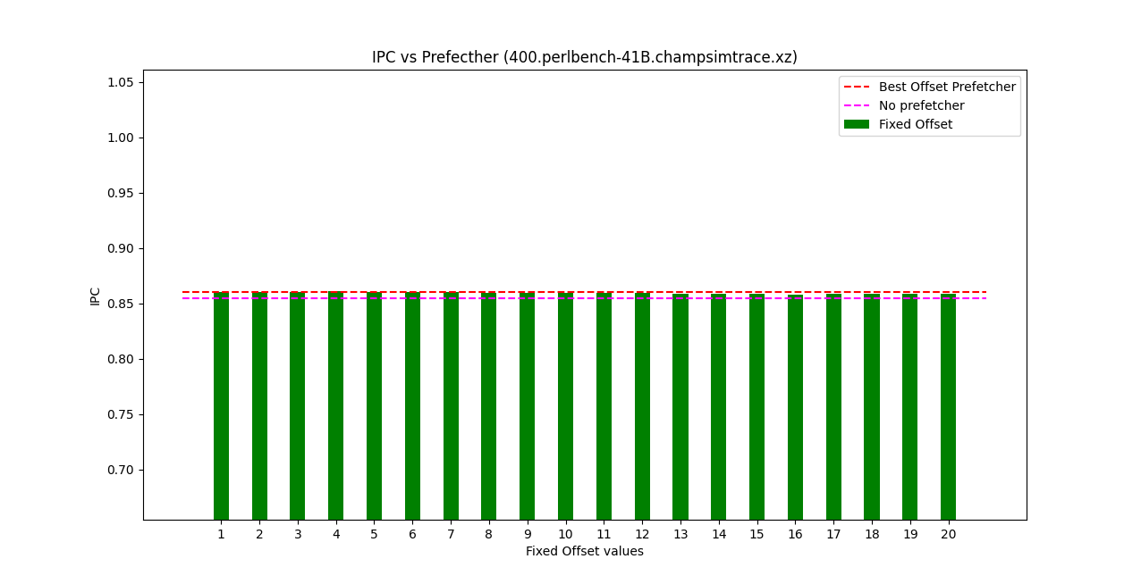
IPC vs. Prefetcher for trace 400.perlbench-41B.champsimtrace.xz

Slide 3
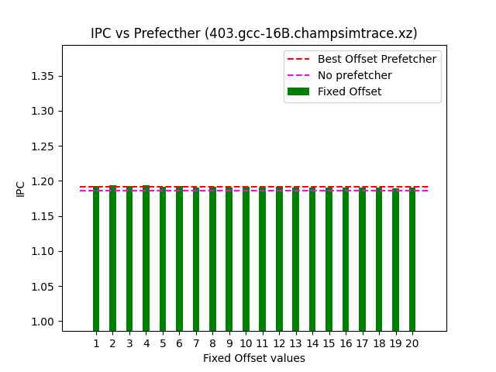
IPC vs. Prefetcher for trace 403.gcc-16B.champsimtrace.xz

Slide 4
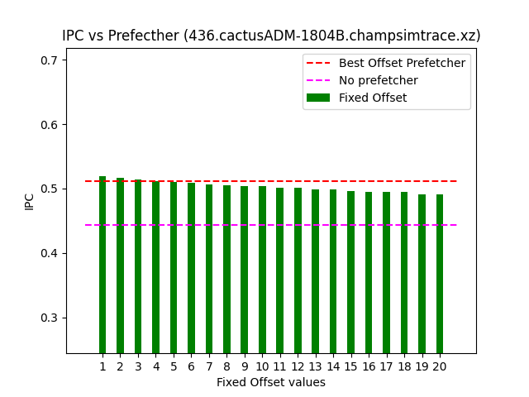
IPC vs. Prefetcher for trace 436.cactusADM-1804B.champsimtrace.xz

Slide 5
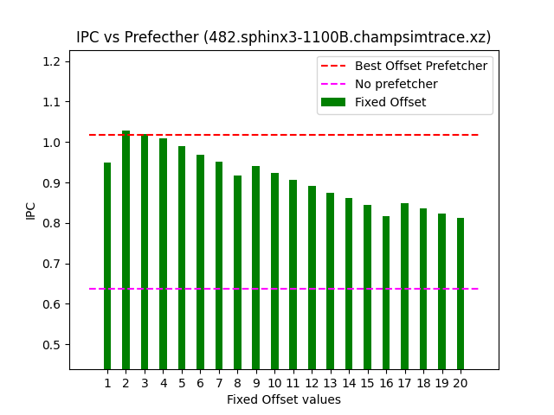
IPC vs. Prefetcher for trace 482.sphinx3-1100B.champsimtrace.xz

